Slide 1
Score pressure and location versus shooting percentage on NBA All Star Selected Players
Charles Tang
Alex Yankalunas
Yuhao Zhao
Fangchen Chen

Slide 2
Introduction
Narrow down over a million shots
All star players are supposed to be the best players
Some players have more all star appearances
We want to know what sets them apart

Slide 3
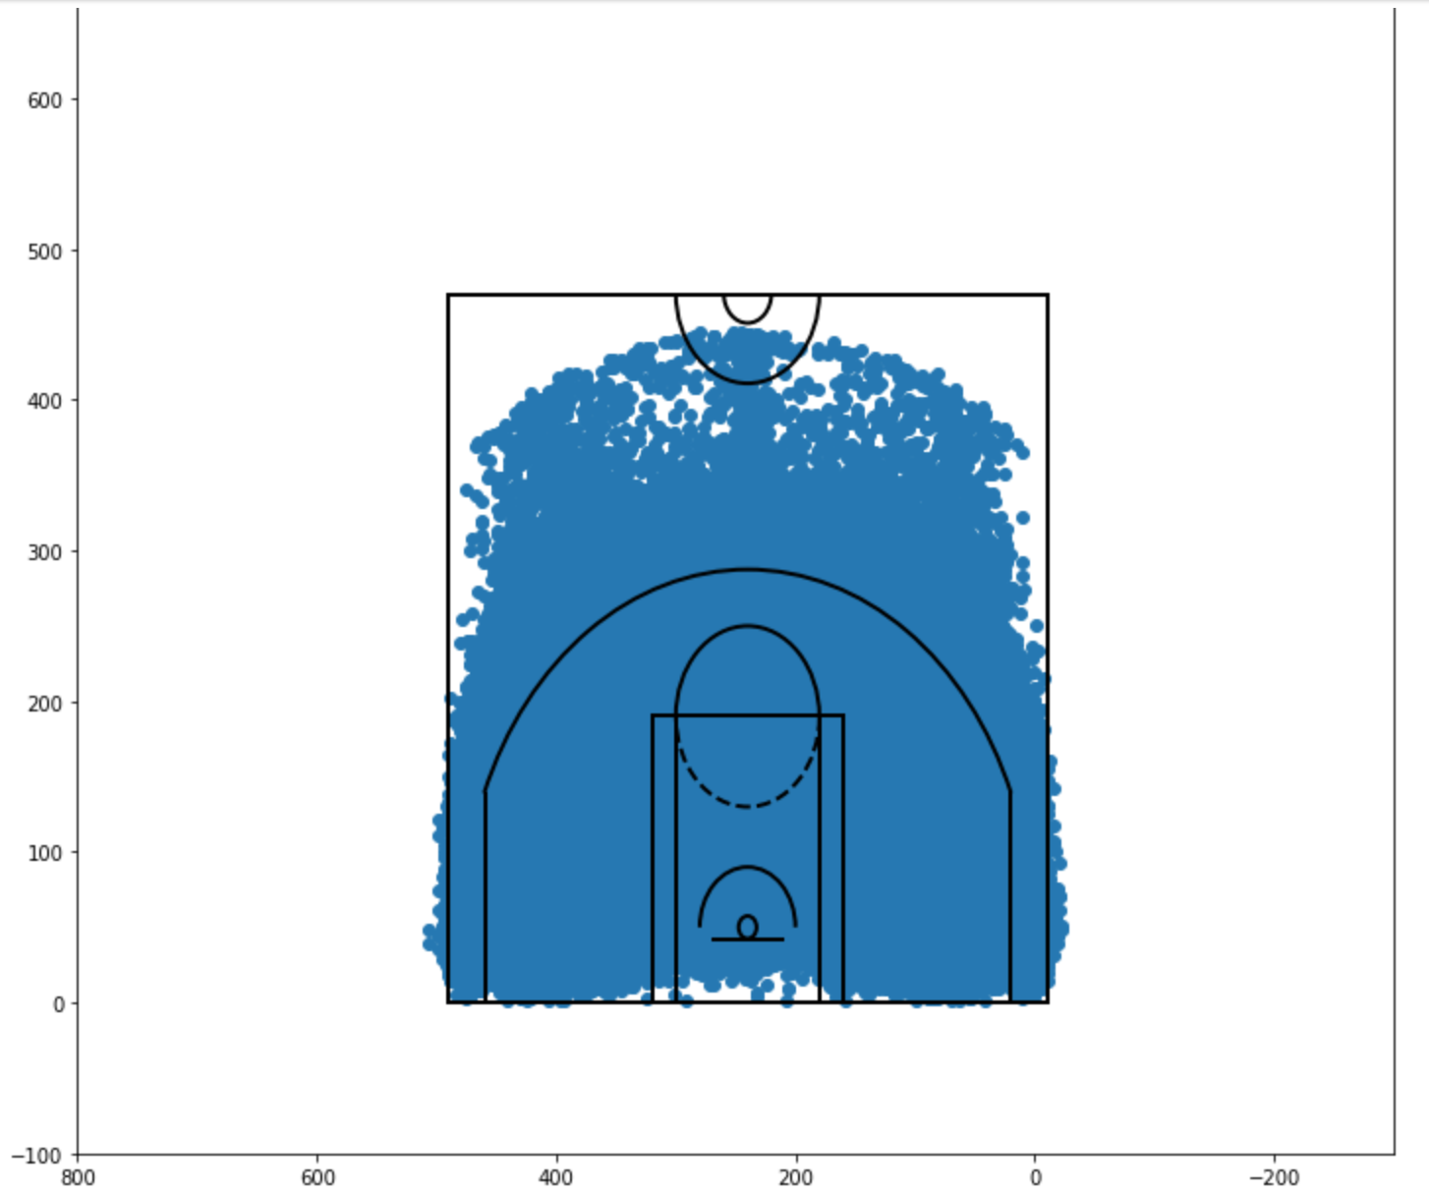
http://savvastjortjoglou.com/nba-shot-sharts.html

Slide 4
Methods
Break the data down into groups
Group 1: 1 appearance
Group 2: 2,3,4 appearances
Group 3: 5 or more appearances
Break down the shooting location
Left, middle, right
Break down the point value
2s vs 3s

Slide 5
Methods
Classify Score Pressure
Behind by 2 baskets
Within 2 baskets
Ahead by 2 baskets

Slide 6
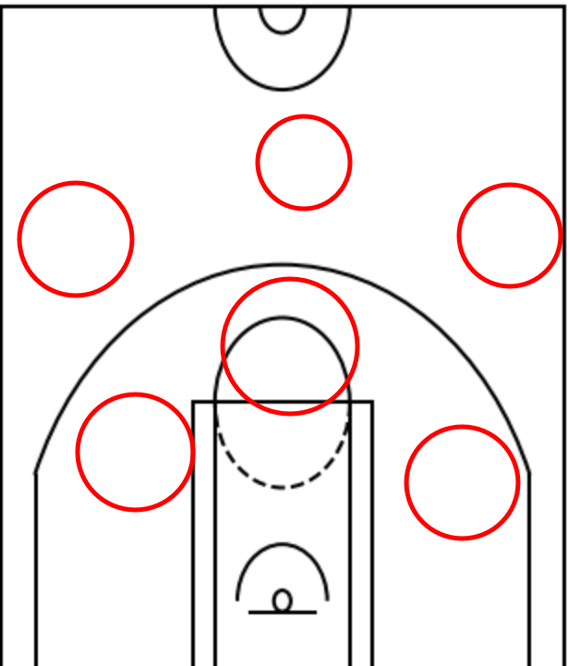

Slide 7
Results
Two point percentages about the same across the board for all groups under respective shooting pressures
38% from behind, 44% from within 2 baskets, and 51% from ahead
Three point percentages show a difference between 1 and multiple appearance all star players
Group 1: 22% from behind, 31% while close, and 40% while ahead
Groups 2,3: 26% from behind, 35%/36% while close, and 45%/46% while ahead

Slide 8
Results
Standard deviations were different between groups
Group 1: 1% for 2s and 2% for 3s
Group 2: 0.8% for 2s and 1% for 3s
Group 3: 0.4% for 2s and 0.8% for 3s
Not directly related to hypothesis but of interest
Players tend to shoot slightly worse from the right
Players tend to shoot 2s better in the middle (by 15% on average) but this doesn’t happen with 3s

Slide 9
Conclusion
Players who make more All Star appearances are more consistent
Players who make multiple All Star appearances are good at shooting threes

